Slide 1

DSCI-501-001 Principal Component Analysis
By
Darshit Rai (dr3264@drexel.edu)
Aman Ostwal (ago34@drexel.edu)
Sanskruti Chavanke (sc4323@drexel.edu)

Slide 2
Index
Introduction
PCA Uses
Understanding the Toy Example
Implementing a Better Way to Look at the Data
Understanding Covariance Matrix
Diagonalization of Covariance Matrix
Understanding how PCA works for Diagonalization
Solving PCA Using Eigenvector Decomposition
PCA with Linear Algebra
Python Code for Implementation of PCA
Benefits of Using PCA

Slide 3
Introduction
What is Principal Component Analysis?
In simple words we can say that Principal Component Analysis (PCA) is a technique used to simplify large datasets by finding a smaller number of features that capture most of the important information. It's like creating a summary of the data that focuses on the key variations. PCA does this by transforming the data into a new coordinate system where the most important features are at the forefront. These new features are called principal components.
PCA relies on some mathematical techniques. PCA uses concepts like eigenvectors and eigenvalues to identify the principal components. Eigenvectors represent the directions of greatest variation in the data, and eigenvalues tell you how much variation each direction captures. PCA prioritizes these directions, keeping the ones with the highest eigenvalues (most variation) as the principal components.

Slide 4
PCA Uses
Quality Control and Manufacturing: PCA is used in manufacturing industries for quality control and process monitoring. By analyzing data from sensors and measuring instruments, PCA can detect patterns or anomalies in production processes, leading to improved product quality and reduced defects.
Recommendation Systems: Recommender systems, like those used by streaming services or online stores, deal with a vast amount of data about user preferences and item attributes. PCA can be used to reduce the dimensionality of this data, making it easier to identify patterns and recommend relevant items to users.
Natural Language Processing (NLP): In NLP tasks like sentiment analysis or topic modelling, text data is often represented using high-dimensional feature vectors. PCA can be used to reduce the dimensionality of this data, making it easier to train machine learning models and improve their performance.
Climate Science and Environmental Data: PCA is used in climate science to analyze large datasets of environmental variables such as temperature, precipitation, and atmospheric pressure. It helps in identifying key climate patterns, understanding their relationships, and making predictions about future climate trends.

Slide 5
Understanding the Toy Example
In the given toy example experiment, we're trying to understand how a ball attached to a spring moves. We want to figure this out by recording its position using three cameras. However, we're not sure which directions are important, so we record in three different angles. The problem is, this creates a lot of confusing data.
Think of it like taking pictures of a bouncing ball from different angles, but not knowing which angle shows the most important information about how the ball is moving. Additionally, there's noise like air disturbances or imperfect camera recordings, making the data even more confusing.
The goal is to use a technique like PCA to simplify this mess of data and find the most critical information. PCA helps us identify the key patterns or directions in the data, sort out the noise, and ultimately understand the underlying dynamics of the ball and spring system more clearly. It's like using a smart tool to untangle a complex puzzle and reveal the hidden simplicity within.

Slide 6
Implementing a Better Way to Look at the Data The idea behind PCA is to find a new set of directions that best explains our data. We're essentially asking if there's a different way to express our data using a combination of the original directions.
Naive Basis
Each sample represents a snapshot of our experiment at a particular time, containing multiple measurements. In the experiment, each sample captures the ball's position from three cameras at a specific moment. An orthonormal basis is like a reference grid used to measure and organize the data. The naive basis, chosen based on how we collected the data, acts as the initial framework for representing our data points.
An orthonormal basis is like a set of directions in which we measure our data. In our toy example, this could be the directions of camera A's x and y axes. The basis vectors are usually chosen to be unit-length and perpendicular to each other, like (1,0) and (0,1) for a simple 2D case.
The reason we choose a specific orthonormal basis for the x and y axes of camera A is because it reflects how we gathered the data. For instance, if we recorded a position like (2,2), it means 2 units up and 2 units to the left in our camera's view, not at an angle.
In linear algebra, we can represent our naive basis like {(1,0),(0,1)} for camera A as row vectors in a matrix. This matrix, called the identity matrix, helps us express all our data in terms of this basis. Each row in the matrix corresponds to an orthonormal basis vector. (continue…)

Slide 7
Change of Basis
Let’s understanding the concept of changing basis. This process involves re-expressing our data in a new set of directions, which can potentially reveal hidden patterns and simplify analysis.
Linear transformation or linearity is a combination of the original basis vectors to best represent our data.
Consider our original data set X, where each column represents a sample or moment in time. We can visualize X as an m x n matrix, where m is the number of measurements and n is the number of samples.
Now, we introduce another matrix Y, which is related to X through a linear transformation represented by matrix P. The equation PX = Y encapsulates this change of basis, where P is the transformation matrix.
Matrix Transformation: P acts as a matrix that transforms X into Y, reshaping our data in a new representation.
Geometric Interpretation: Visualize P as a combination of rotation and stretching operations, morphing X into Y in a geometric sense.
New Basis Vectors: The rows of P, denoted as {p1, ..., pm}, serve as a fresh set of basis vectors for expressing the columns of X in a different coordinate system.
Breaking down the equation PX = Y reveals insights into how the basis change occurs. Each column of Y, denoted as yi, is a projection onto the basis defined by {p1, ..., pm}. In simpler terms, the coefficients of yi are obtained by projecting the corresponding column of X onto the rows of P.

Slide 8
Understanding Covariance Matrix
Understanding relationships and redundancies within sets of measurements. Let's explore what the covariance matrix is, how it quantifies relationships, and its significance in data analysis.
The covariance between two sets of measurements, A and B, is a measure of their linear relationship. A positive covariance indicates a positive correlation, while a negative covariance signifies a negative correlation. The magnitude of the covariance reflects the degree of redundancy between the variables.
To understand this concept with higher dimensions, we consider multiple sets of measurements denoted as x1, x2, ..., xm. These measurements can be organized into a matrix X, where each row represents a measurement type, and each column represents a trial or sample.
The covariance matrix, denoted as Cx, is computed as the product of X and its transpose divided by the number of samples. Each element in Cx represents the covariance between different measurement types. The diagonal elements represent the variance of individual measurement types, while off-diagonal elements represent covariances between pairs of measurements.
What can we infer from covariance matrix?
It is symmetrical, meaning Cx is a square symmetric matrix. It is equal to its transpose.
Diagonal elements of Cx are variances, and off-diagonal elements are covariances between measurement types.
Large off-diagonal values in Cx indicate high redundancy between measurement types, while large diagonal values suggest interesting structures in the data.

Slide 9
Diagonalization of Covariance Matrix
Our ideal scenario involves a covariance matrix Cy with zero off-diagonal terms. This translates to a diagonal matrix, signifying that the variables in the transformed data Y are decorrelated. A lower covariance indicates less redundancy in the data.
Additionally, the diagonal elements of Cy should be ranked in descending order, representing the variances of each variable in Y. Higher variance implies more significant variations in the data.
Optimized Covariance Matrix CY:
A diagonal covariance matrix implies no redundancy between variables. Each variable in the transformed data Y contributes unique information.
The variances on the diagonal prioritize the most informative directions in the data. Variables with higher variances capture a larger portion of the overall signal.

Slide 10
Understanding how PCA works for Diagonalization
All basis vectors used for transformation are orthonormal. This means they are perpendicular to each other and have a unit length.
Similarly, PCA acts like a rotation in higher dimensions. The orthonormal basis vectors become the new axes, along with the directions of maximum variance.
Steps of PCA for Diagonalization:
1. We will start with the original data X.
2. Then we will find the direction in the data space that captures the most variance. This becomes the first principal component (p1).
3. Now, search for another direction with the highest variance, but constrain it to be perpendicular to p1. This becomes the second principal component (p2).
4. We will repeat step 3 until we have as many principal components (p's) as the original number of variables (m).

Slide 11
Solving PCA Using Eigenvector Decomposition
What we understand from the paper is that a transformation matrix P that transforms the data X into a new space Y where the covariance matrix Cy becomes diagonal. The rows of P represent the principal components, the new informative directions in the data.
Let’s get through the steps of eigenvalue decomposition:
We start by expressing Cy in terms of the unknown transformation matrix P leading to Cy = PCxP^T and the original data X.
The covariance matrix captures the average product of deviations from the mean, for each pair of variables. We will calculate the covariance between all possible pairs of variables in the original data matrix (X).
Now, we can find a special set of eigenvectors and a diagonal matrix containing eigenvalues that represent Cx in a simpler form.
We choose the transformation matrix P to have each row pi as an eigenvector of Cx.
By substituting this choice of P to be a matrix where each row is an eigenvector of Cx = 1/nXX^T, we can demonstrate that Cy becomes a diagonal matrix D. This fulfils our goal of decorrelating the data in the transformed space Y.
The i^th diagonal value of Cy is the variance of X along Pi .

Slide 12
PCA with Linear Algebra
Let’s see how Linear Algebra and our course DSCI-501 has clarified and has been useful in implementing Principal Component Analysis(PCA).
An orthogonal matrix A has the property that its transpose (AT) is also its inverse (A^−1). Mathematically, A^TA = I implies that A^−1 = A^T.
For any matrix A, A^TA and AA^T are symmetric.
A matrix is symmetric if and only if it is orthogonally diagonalizable. This means that for a symmetric matrix A, there exists an orthogonal matrix E and a diagonal matrix D such that A = EDE^T.
A symmetric matrix is diagonalized by a matrix of its orthonormal eigenvectors. This property is fundamental in PCA, as it enables us to find the principal components of the data by diagonalizing the covariance matrix.
For any arbitrary matrix X, the symmetric matrix X^TX has orthonormal eigenvectors {vˆ1,vˆ2,...,vˆn} and associated eigenvalues {λ1,λ2,...,λn}. These eigenvectors form an orthogonal basis, and the eigenvalues represent the variances along each eigenvector direction.
In conclusion, linear algebra concepts such as orthogonal matrices, symmetry, eigenvectors, and eigenvalues are fundamental tools used in implementing PCA. They allow us to transform data into a new basis, extract meaningful features, and reduce dimensionality while preserving important information about the data's variability.

Slide 13
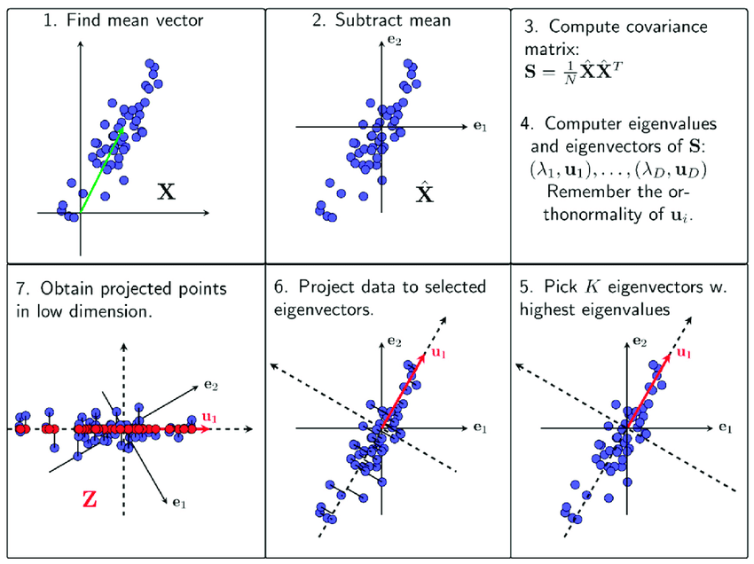
PCA Process Overview

Slide 14
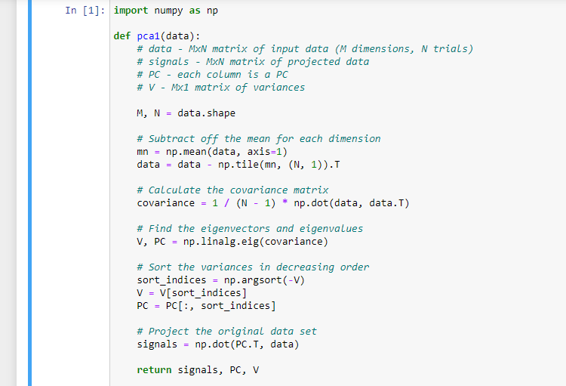
Python Code for Implementation of PCA
We import the NumPy library to perform numerical computations efficiently.
The pca1 function takes a data matrix as input and returns the projected data (signals), principal components (PC), and variances (V).
We calculate the mean (mn) along each dimension and subtract it from the data matrix to center the data around zero.
We compute the covariance matrix (covariance) using the centered data.
Using NumPy's linalg.eig function, we find the eigenvectors (PC) and eigenvalues (V) of the covariance matrix.
We sort the eigenvalues in decreasing order and rearrange the corresponding eigenvectors accordingly to obtain the principal components (PC) and variances (V).
Finally, we project the original data onto the principal components (PC) to obtain the projected data (signals).

Slide 15

Benefits of Using PCA:
By compressing the data into fewer important features, PCA makes it easier to analyze and visualize complex datasets.
Many machine learning algorithms struggle with high-dimensional data. PCA helps by reducing the dimensions, making it easier for these algorithms to learn effectively from the data.
Sometimes, datasets can have irrelevant information called noise. PCA can help filter out this noise by focusing on the core variations in the data.
PCA is a powerful tool for dimensionality reduction and data analysis. It helps us to see the bigger picture in complex datasets and prepares our data for further exploration or machine learning tasks.

Slide 16
Summary
Principal Component Analysis (PCA) is an effective method that helps to make large datasets easier to understand by identifying the most significant patterns or trends within the data. It involves transforming the data into a new coordinate system in which a smaller set of features known as principal components capture the majority of the changes.
The key steps involved in PCA are:
We start with the original data matrix X, where each column represents an observation.
Then we calculate the covariance matrix Cx of the data, which quantifies the relationships and redundancies between different measurements.
Perform eigenvalue decomposition on the covariance matrix Cx to find its eigenvectors and eigenvalues.
Choose the transformation matrix P such that its rows are the eigenvectors of Cx, sorted in descending order of their corresponding eigenvalues.
Transform the data into a new space Y = PX, where the covariance matrix Cy becomes diagonal, with diagonal elements representing the variances along each principal component.
The principal components are the new orthogonal axes that capture the maximum variance in the data, with the first principal component capturing the largest variance, the second capturing the second-largest variance, and so on. By retaining only the most significant principal components, PCA can effectively reduce the dimensionality of the data while preserving the essential information.

